Slide 1

Two-Port Representation of Transmission Lines: Transmission Line Networks
Farhad Rachidi
Swiss Federal Institute of Technology (EPFL)
EMC Laboratory
Farhad.Rachidi@epfl.ch
http://emc.epfl.ch

Slide 2
Transmission Line Networks
Simple transmission lines are often connected together in the form of a network
  Such networks can be represented by a linear graph
Network
Nodes, or “Junctions”
Graph
Source
The goal of such an analysis is to compute the load voltage and current, as well as the radiated EM fields
Branches, or “Tubes”

Slide 3
Solutions for Transmission Line Networks
Several different solution approaches can be developed for transmission line networks, including
  Cascading 2-port circuits
  Network order reduction, or “collapsing”
  Use of the BLT equation
  Signal flow methods
We will illustrate the first two approaches here

Slide 4
Networks of Cascaded Sections
The simplest transmission line network is one consisting of 2 or more cascaded transmission lines:
Each section of line can be considered as a single section of transmission line without sources
  Each of some characteristic length L_{n}

Slide 5
Review of 2-Port Circuit Representations
Two-port circuit can be represented by various relationships between voltage and current at the terminals
  Impedance (or Z) parameters
  Admittance (or Y) parameters
  Chain (or ABCD) parameters
Note the change in current direction for the chain parameters.

Slide 6
Review of Chain Parameters
The chain parameters, relating v and i at one port to v and i at another port, are very useful for transmission line analysis
– Reciprocity requires that (AD-BC)=1
– The inverse is also a chain parameter matrix:

Slide 7
Chain Parameters
Loaded two-port excited by a Thévenin circuit

Slide 8
Chain Parameters (con’t.)
Chain parameters are useful for representing cascaded 2-port circuits
[C_{T}] = [C_{A}] [C_{B}].

Slide 9
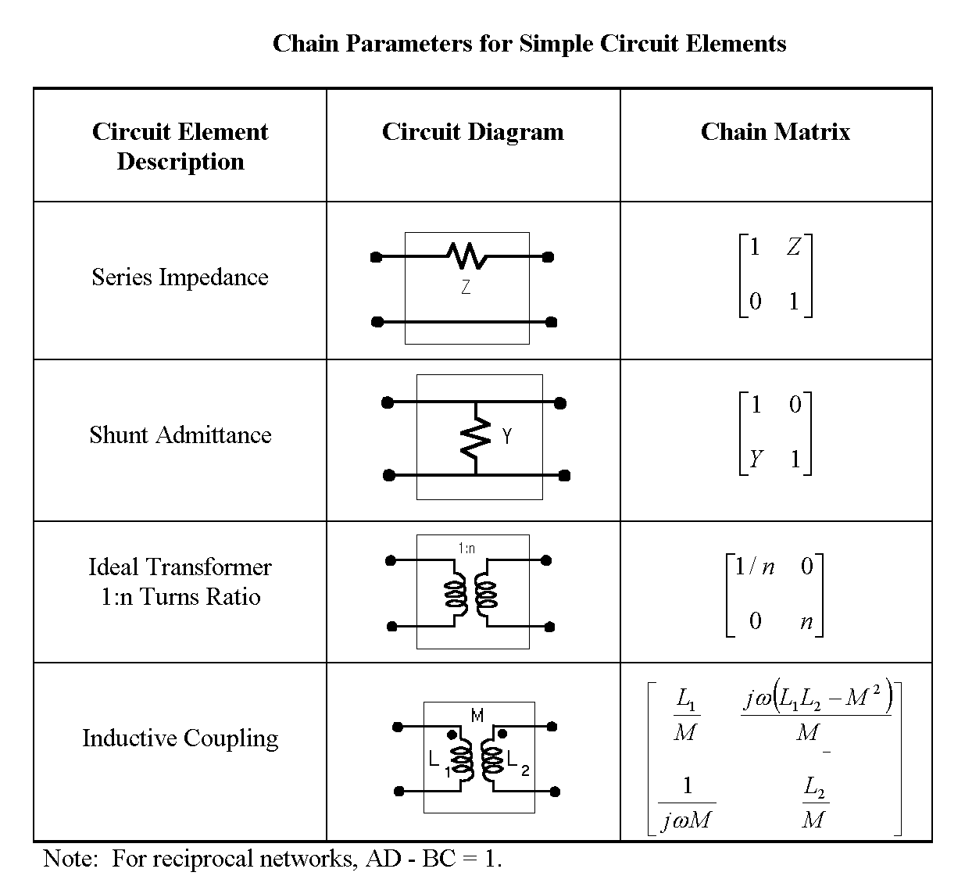
Chain Parameters (con’t.)
Summary of chain parameters for different circuit elements

Slide 10
Chain Parameters (con’t.)
Illustration of the use of chain parameters for a simple circuit

Slide 11
Chain Parameters (con’t.)
Use of chain parameters for an N-section ladder network

Slide 12
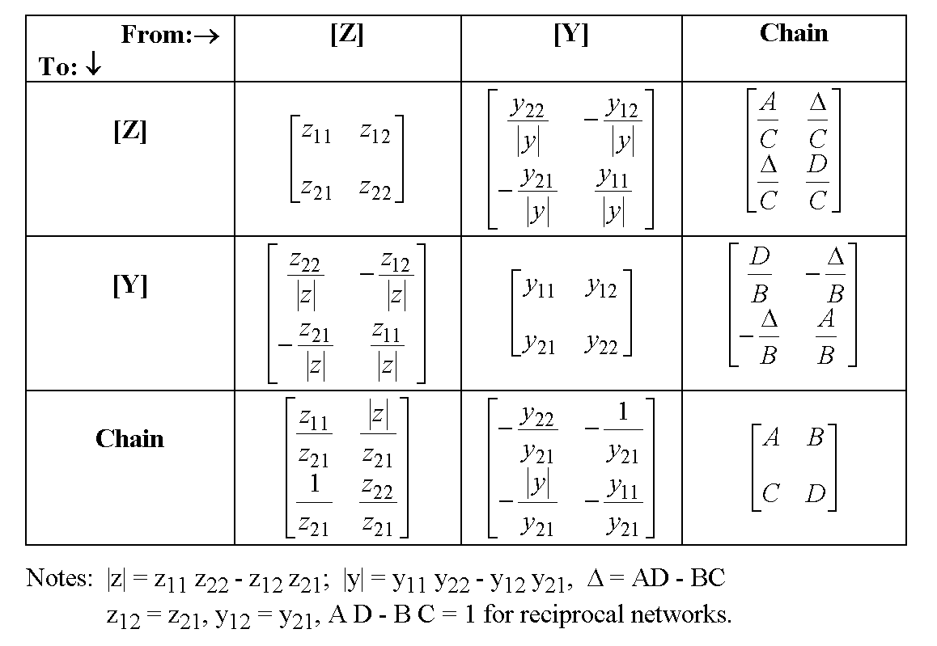
Relationship between Parameters
This chart can be used to convert from one set of parameters to another
Note that these parameters are not defined when the determinants are zero

Slide 13
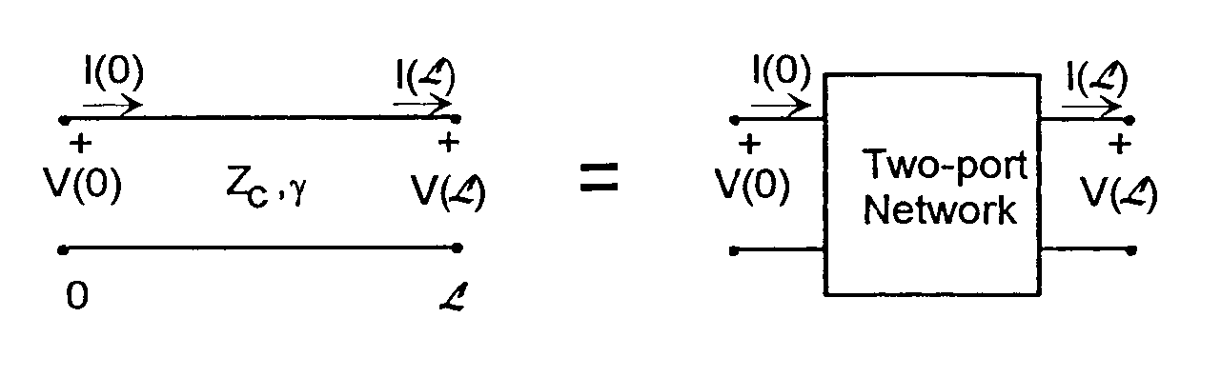
Two-Port Representation of a TL Section
A transmission line of length L can be regarded as a two-port network at its ends.
As such, its terminal v-i relationships can be represented by several different, but equivalent forms:
Chain Parameters:
Impedance Parameters:
Admittance Parameters:
[3] Tesche, F.M., “EMC Analysis Methods and Computational Models, John Wiley & Sons, 1997.
We will derive this in the next slide
Note that I(x) denotes the line current, which is in a different direction from the current at port 2 in the 2-port circuit representation. Hence there is a change in sign here.

Slide 14
Derivation of the Chain Parameters for a TL
On a source-free section of TL, we have shown that the line voltage and current consist of a positive and negative traveling waves of the form
At x = 0, V(0) and I(0) can be written as
Similarly, at x = L, V(L) and I(L) are
expressed as

Slide 15
Derivation of the Chain Parameters for a TL
Inverting this last equation gives
Inserting this expression for into the previous equation for gives

Slide 16
Derivation of the Chain Parameters for a TL
Thus, we have the v-I relationships for the
2-port as
Chain parameters

Slide 17
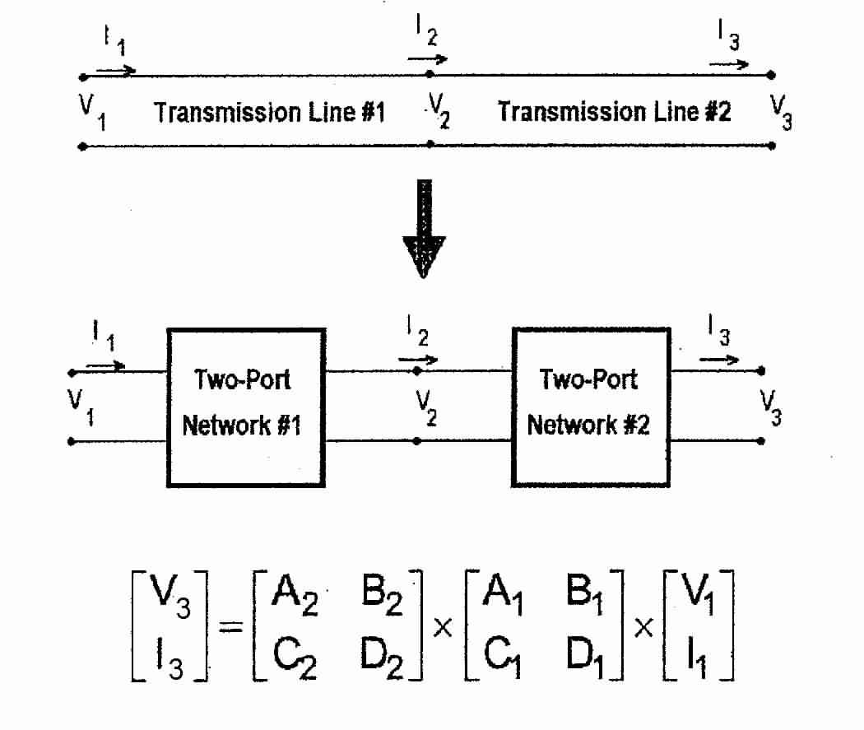
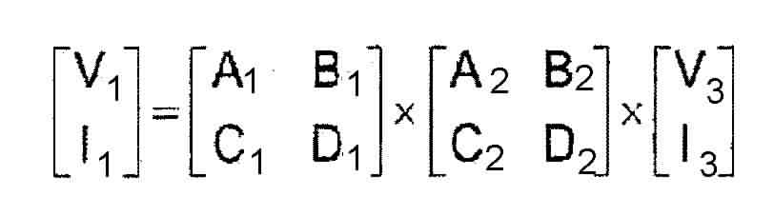
Cascaded TL Sections
Just like the circuit case, two or more cascaded lines can be treated by multiplying the chain parameter matrices for each section

Slide 18
TL Network Solutions
Once the chain parameters of the cascaded line sections are known, the load response of a loaded line can be found
  Excitation is assumed to be from a Thevenin source
Cascaded TL network represented by the chain parameters
[C]
– The load current and voltage are given in terms of the chain
parameters as

Slide 19
Thévenin and Norton Representation of a TL
The source and impedance at one end of a line can be collapsed to provide a simple equivalent circuit
Thevenin parameters

Slide 20
Example of a more Complicated TL Network
Consider a shielded building with an entering power line
  The line passes through a
  weatherhead connection
  and enters into the building.
  The cable fans out into
  several different internal lines
This power line forms a
network that is capable of
transmitting external EM
noise into the building
An analysis of the EM
propagation is desired

Slide 21
Example of a more Complicated TL Network
For calculating the propagation and penetration of energy along the network, the following model can be considered

Slide 22
A TL Circuit Model is Formed
The interconnection of transmission lines developed in the system model can be represented as a distributed circuit model

Slide 23
TL Network Details

Slide 24
TL Network Details
EMI source and line impedance

Slide 25
TL Network Details
External power line

Slide 26
TL Network Details
External portion of conduit

Slide 27
TL Network Details
Grounding resistance of conduit in earth

Slide 28
TL Network Details
Individual line segments inside building
Internal region of conduit

Slide 29
Network Analyzed using Thévein/Norton Transformations
The source and impedance at one end of a line can be collapsed to provide a simple equivalent circuit
Thevenin parameters

Slide 30
Circuit Model
For simple tree graphs (without loops) the overall network can be collapsed to a single lumped circuit

